Slide 1
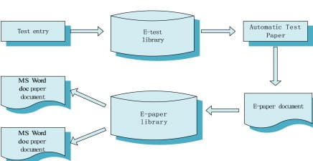
System Architecture
Fig: System Architecture

Slide 2
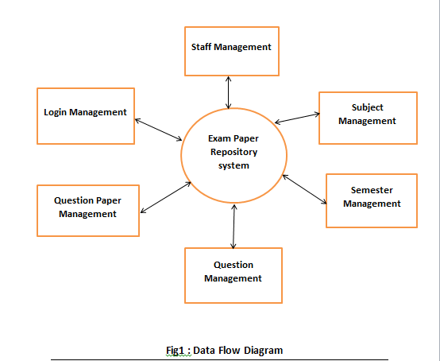
Data Flow Diagram

Slide 3
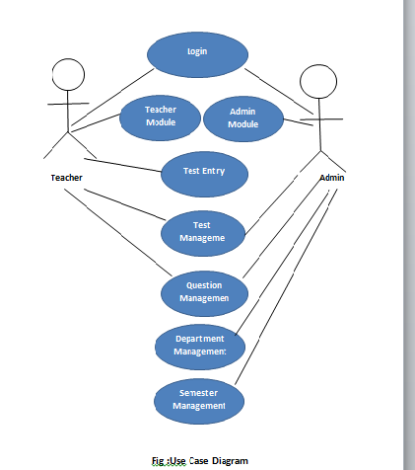
Use Case Diagaram

Slide 4
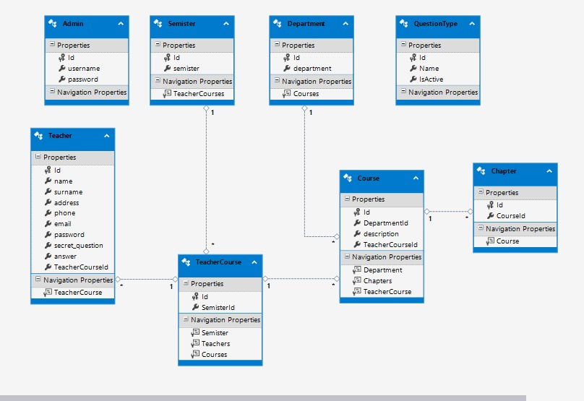
Class Diagram
Fig: Class Diagram

Slide 5
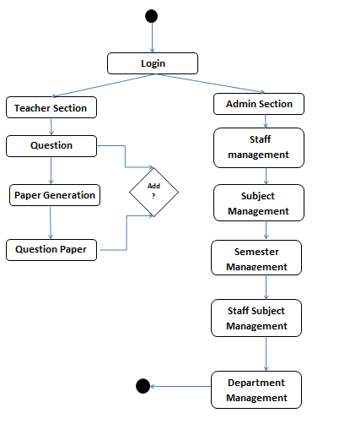
Activity Diagram
Fig: Activity Diagram

Slide 6
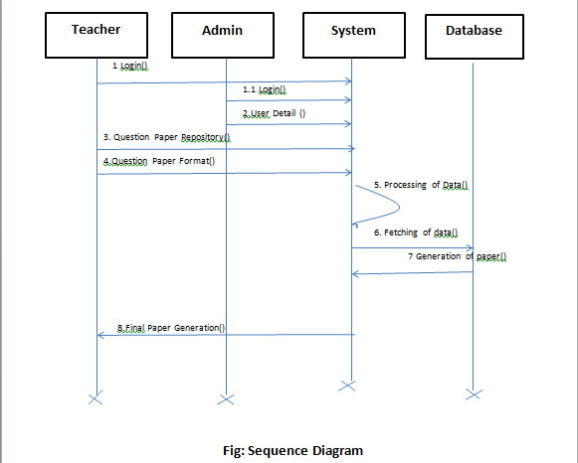
Sequence Diagram

Slide 7
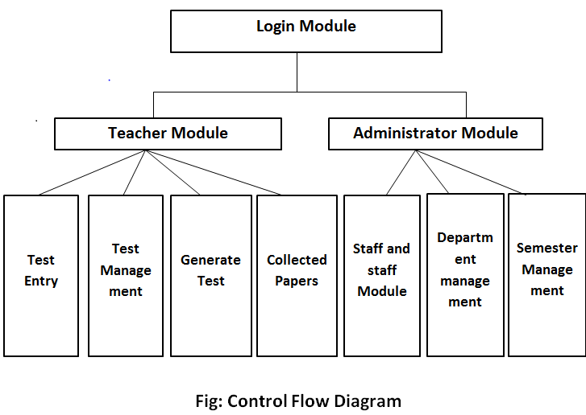
Control Flow Diagram

